Slide 1
Lecture 2: Algorithm Complexity
Tsung-Wei (TW) Huang
Department of Electrical and Computer Engineering
University of Utah, Salt Lake City, UT
Notes:
Alright, let’s get started. Today we are going to talk about algorithm complexity. This is a very important but a little bit theoretical topic for us to formally understand whether an algorithm is good or not, or whether a problem can be solved efficiently or not using today’s machines.

Slide 2
Recap: We Need Algorithms!
To optimize design among different objectives, area, power, performance, and etc.
Fundamental questions: How to do it smartly?
Definition of algorithm in a board sense: A step-by-step procedure for solving a problem. Examples:
Cooking a dish
Making a phone call
Sorting a hand of cards
Definition for computational problem
A well-defined computational procedure that takes some value as input and produces some value as output
Notes:
Last time, we talk about several physical design problems and their importance in the overall design flow. Solving these problems means optimizing design among different objectives, area, power, performance, and so on so forth.
One of the fundamental question is that how do we do it smartly? Well, we need algorithms, and the definition of algorithm is …

Slide 3
Recap: Big Mod Problem
Computational problem description
Input: a, b, c (3<a, c<5000000, 1<b<2147483647)
Output: x = a^{b} (mod c)
A simple solution
for(i=1, x=1; i<=b; i++)
x = (x*a)%c;
std::cout << “a^b % c = ” << x << std::endl;
Is the solution smart enough?
We need a total of “b” iterations
Very slow execution for large b
Notes:
We also went through a famous example, also a very frequently asked interview question, the big mod problem. This is a computational problem, meaning that you can solve it computationally or write a software program to solve it on a computer hardware. The problem description is as follows: …

Slide 4
Recap: Recursive Solution
Input: a=2, b=16, c; Output: x = a^{b} (mod c)
Simple solution needs a total of b=16 iterations
Let’s refine the iteration count recursively
2¹⁶ = ( 2⁸ )² total 1 calculation
2⁸ = ( 2⁴ )² total 1 calculation
2⁴ = ( 2² )² total 1 calculation
2² = ( 2¹ )² total 1 calculation
2¹ = ( 2⁰ ) total 1 calculation

Slide 5
Recap: Recursive Solution (cont’d)
#define SQUARE(x) (x*x)
int bigmod(int a, int b, int c) {
if(b==0) return 1;
else if(b%2==0)
return SQUARE(bigmod(a,b/2,c)%c)%c;
else return ((a%c)*bigmod(a,b-1,c))%c;
}
int main() {
int a,b,c;
while(std::cin >> a >> b >> c) std::cout<<bigmod(a,b,c)<<endl;
return 0;
}
2¹⁶ = ( 2⁸ )² total 1 calculation
2⁸ = ( 2⁴ )² total 1 calculation
2⁴ = ( 2² )² total 1 calculation
2² = ( 2¹ )² total 1 calculation
2¹ = ( 2⁰ ) total 1 calculation

Slide 6
Recap: Iterative Version
int bigmod(int a, int b, int c) {
int result = 1;
while(b > 0) {
if(b & 1) {
result = (result * a) % c;
}
b = b >> 1;
a = a*a%c;
}
return result;
}
Notes:
For that recursive algorithm, we can alternatively rewrite it without any recursions. This slide shows the same algorithm implemented using while-loop only. There is no recursion.
What is the motivation of doing this?

Slide 7
Recap: Runtime Comparison
https://www.onlinegdb.com/
Runtime (with –O2) – Enabled Optimization
(a, b, c) | Naive | Refined (recursive) | Refined (iterative)
(2, 1000000, 3) | 13720 us | 24 us | 22 us
(2, 10000000, 3) | 136148 us | 9 us | 4 us
(2, 100000000, 3) | 1320049 us | 8 us | 4 us
Notes:
Different algorithms clearly give you different advantages, in terms of performance. This is always the top priority you should consider when designing an algorithm to solve a computational problem.
This table compares the runtime among the three different methods under three different b values. On the first row here, I have b equal to 1M, … (explain)

Slide 8
Recap: Code Analysis
https://godbolt.org/z/6zT4cK3Wz
 | Naive | Refined (recursive) | Refined (iterative)
Lines of C++ Code | 7 | 11 | 11
Lines of Assembly (-O0) | 55 | 99 | 59
Lines of Assembly (-O2) | 27 | 57 | 32
Notes:
The next question we asked was what is the difference between the recursive solution and the iterative solution for the refined algorithm? We know both run very fast and implement pretty much the same algorithm idea to reduce the iteration number in an optimal manner. What is the difference between them?
We said this is a very important question you should always ask yourself when writing code to implement algorithms.
The best way to understand this is to see what the machine actually sees your code. All the code we have written is designed to be high level or, human-readable. The code we just wrote is not what the machine actually sees. To reveal the secret behind the code, we can go to the website, compiler explorer, and see what the compiler does for us to generate machine code that executes the code we wrote. (explain)

Slide 9
Computational Complexity
Computational complexity is an abstract measure of the time and space necessary to execute an algorithm as function of its input size
The input is the graph G(V,E)
input size = |V| and |E|
The input is the truth table of an n-variable Boolean function
input size = 2^{n}
What’s the growth of algorithm complexity in terms of input size?
Best case?
Worst case?
Notes:
Any question so far before we move on to today’s topic? How many of you have ever taken the algorithm course?
We just went through an example and understood different algorithms actually matter in terms of performance. Now, we want to formally define what computational complexity really means. (explain …)

Slide 10
Time and Space Complexity
Time complexity describes elementary computational steps
Ex: addition (or multiplication, or value assignment etc.) is one step
Normally, by "most time-efficient" algorithm we mean the fastest runtime to reach the goal
Space complexity describes memory usage
Ex: in bits, bytes, words
Normally, by “most space-efficient” algorithm we mean the lowest memory usage
Notes:
There are two types of complexity, time complexity and space complexity. (explain …)

Slide 11

Analysis of an Algorithm
We need some way to compare different algorithms
Usually the run time is the criteria used
However, difficult to compare since algorithms may be implemented in different machines, use different languages, etc.
Also, run time is input-dependent.
Which input to use?
Which case do we consider? Worst or best?
...
Notes:
Space and time complexity combine to let us understand which algorithm is better or worse than another. If you have an algorithm of a very high time and space complexity, that algorithm is very likely to be very bad. But, how do we actually perform the comparison? We need some way to compare different algorithms.
In practice, the runtime is the criteria used to compare different algorithms because we usually care about the speed. Nobody want to wait until an hour after you turn on the phone to use. However, (explain …)

Slide 12
Big-O Notation
Consider runtime for the worst-case input
upper bound on runtime
Express runtime as a function of input size n
Interested in the run time for large inputs
Therefore, interested in the growth rate
Ignore arithmetic operations
+,-,x,/,… operators treated as constant-time computations
Ignore lower order terms
Eventually, the highest order dominates the growth
Notes:
Although there are many aspects to consider when comparing different algorithms for solving certain problems, the widely used convention is the Big-O notation. Big-O notation is used to consider runtime for the worst case input! Why? Because worst-case input typically gives you the upper bound on the runtime of your algorithm. Let’s say your algorithm can finish 99% cases very quickly but for this particular input you run forever, then that algorithm is not so good, right?
The way big-O notation works is to express runtime as a function of input size N. (explain …)

Slide 13
Big-O Notation (cont’d)
g = O(f), if two constants n₀ and K can be found such that for all n ≥ n₀ :
g (n) ≤ K ⋅ f(n)
Examples:
2n² = O(n²)
2n² + 3n +1 = O(n²)
n^{1.1}+10000000000n is O(n^{1.1})
n^{1.1} = O(n²)
Notes:
The formal definition of Big-O notation is as follows: suppose you have two functions g and f, both are expressed as the input n, we say g is bog-O f is …

Slide 14
Example: Big-Mod Complexity
Compute a^{b} mod c (b is as large as 2147483647)
Naïve method
for(i=1, j=1; i<=b; i++)
j = (j*a)%c;
2¹⁶ = 2*2*2*2*2*2*…*2 total 16 iterations
Refined solution
2¹⁶ = ( 2⁸ )² total 1 iteration
2⁸ = ( 2⁴ )² total 1 iteration
2⁴ = ( 2² )² total 1 iteration
2² = ( 2¹ )² total 1 iteration
2¹ = ( 2⁰ ) total 1 iteration
What is the space and time complexities for each method in terms of big-O notation?
Notes:
Let’s take at the big mod example.

Slide 15
Example: Selection Sort
Input: An array of n numbers D[1]…D[n]
Output: An array of n numbers E[1]…E[n] such that
E[1] E[2] … E[n]
Algorithm:
For i from 1 to n do
Select the largest remaining number from D[1..n]
Put that number into E[i]
What is the space and time complexities for each method in terms of big-O notation?
Notes:
Let’s take a look at another example: selection sort. Selection sort is an algorithm that sorts a range of number in either increasing or decreasing order. The problem description is as follows: (explain…)
The algorithm works like this: (explain …)

Slide 16
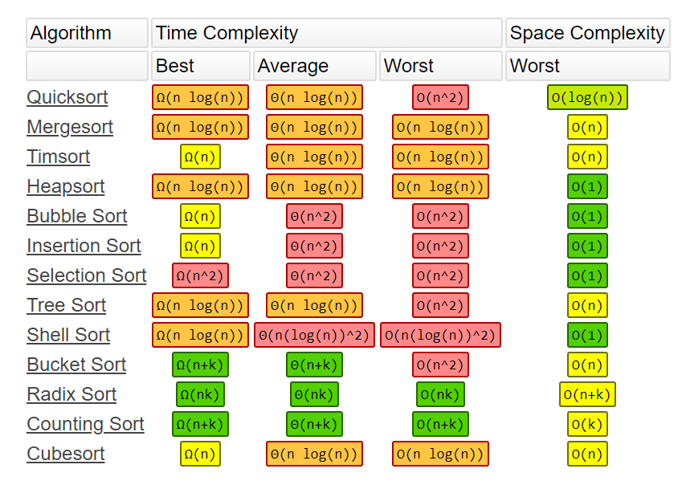
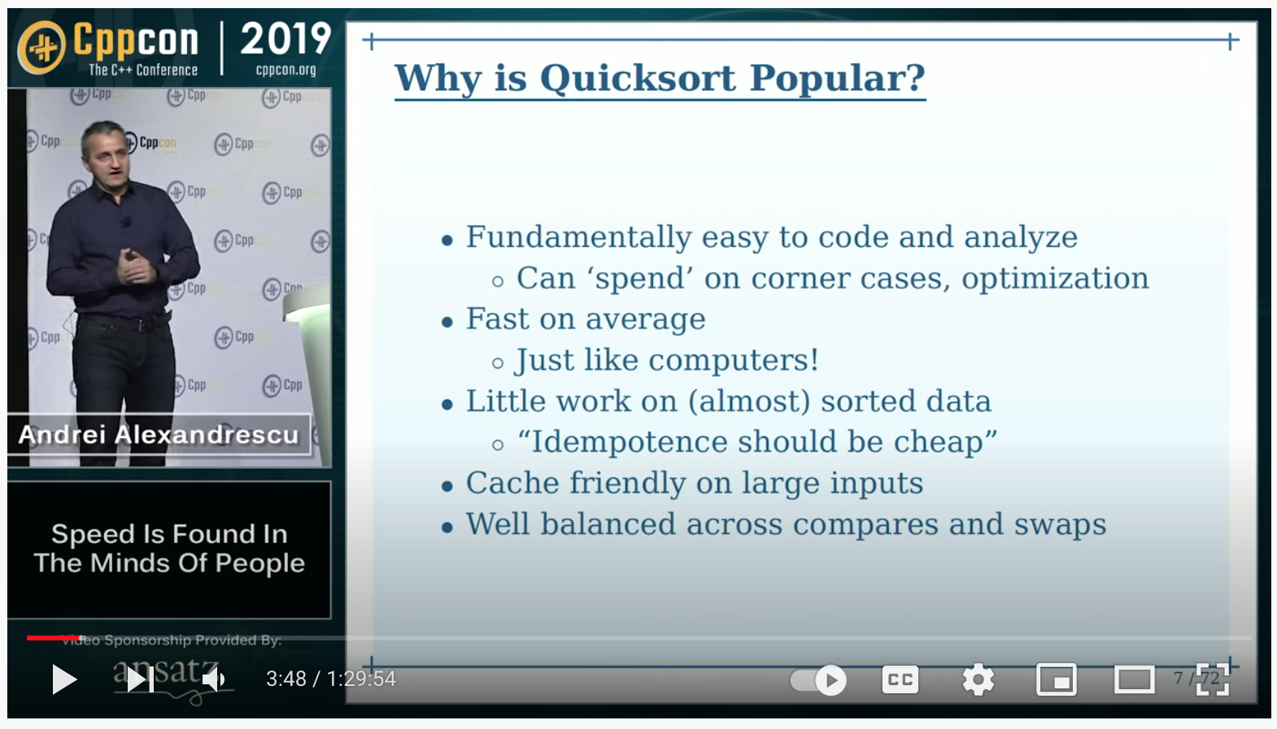
Time Complexity of Sorting Algorithms
Andrei Alexandrescu, “Speed is Found in Minds of People,” CppCon 2019 (https://www.youtube.com/watch?v=FJJTYQYB1JQ)
Notes:
We know sorting is a very fundamental algorithm in solving pretty much all computer science and computer engineering problems. There are various sorting algorithms available today and each of them has its own pros and cons, with different time complexity. For example, the quicksort algorithm has a best-case time complexity nlogn and worst-case complexity n2. The merge sort has nlogn for all situations.
If the numbers you need to sort are all integers, you can use radix sort to get a complexity close to linear time.
Because of the importance, still today many people are inventing new sorting algorithms. For example, Andrei who was a former engineering in Facebook gave a talk about how he invented a new sorting algorithm in Cpp Conference 2019. I highly encourage you to watch the video.

Slide 17
Empirical Analysis
On modern computers (e.g., Intel i5/i7 2.5-3.5GHz)
O(N) = 1000000 ~ 8000000 takes about 1s to finish
Generally true on modern PCs
Big-O complexity for an input size N
O(N)
for(int i=1; i<=N; i++) some_constant_work();
O(N²)
for(int i=1; i<=N; i++)
for(int j=1; j<=N; j++)
some_constant_time_work();
O(N³), O(N⁴)…
How long does these loops take?
Notes:
That is the theoretical side of Big-O notation. You describe a complexity in terms of the input size and then compare different ones at the worst-case. If your big-O complexity is larger than mine, your algorithm is considered to be bad. However, when it comes to practice, we need a sense about the relationship between a big-O complexity and the actual runtime it is going take.
So, this slide tells you the empirical analysis I came up with from my 10-year programming experience. I am going to tell you roughly how much time it is going to take for a big-O complexity. On a modern computers (like intel i6 or i7 at 2.5 or 3.5 GHz), running a big-O N algorithm with N equal to 1M to 8M takes about 1 second.
For example, (explain)

Slide 18
Empirical Analysis (cont’d)
A Problem with N = 1000, Time Limit = 1s
Could an O(N) algorithm pass the time limit constraint?
What about the O(NlogN)?
What about the O(N²) ?
What about the O(N² logN) ?
What about the O(1) time ?
A Problem with N = 1000000, Time Limit = 1s
Could an O(N) algorithm pass the time limit constraint?
What about the O(logN) ?
What about the O(logN logN) ?
What about the O(N²) ?
Notes:
This empirical analysis gives you a very good sense about the timing constraint, especially for applications that need to run in real time. For example, I can ask the following questions: (explain …)

Slide 19
Applicable to Various Algorithm Designs
Greedy
Divide and Conquer
Dynamic programming
Graph algorithms
Analytical algorithms
Linear programming
Integer linear programming
Quadratic programming
…
Notes:
With that empirical analysis in mind, next time when you design an algorithm you can roughly estimate how long it is going to take. And, you can use this techniques to analyze the runtime for various algorithms such as greedy, divide and conquer, dynamic programming, graph algorithms, and analytical algorithms.

Slide 20
Exponential Time Complexity
An algorithm has an exponential time complexity if its execution time is given by the formula
execution time = k₁·(k₂)^{n}
where n is the size of the input data and k₁, k₂ are constants
Ex: O(2^{n}), O(n²3^{n}), …
Notes:
When you design algorithms, you should avoid exponential complexity. An algorithm has an exponential time complexity if its big-O notation has input size N in the exponent. For example … ()

Slide 21
Problem of Exponential Function
Consider O(2^{n}), value doubled when n is increased by 1
If you borrow $10 from a credit card with APR 18%, after 40 yrs, you will owe $12700!
n | 2^{n} | 1μs x 2^{n}
10 | 10³ | 0.001 s
20 | 10⁶ | 1 s
30 | 10⁹ | 16.7 mins
40 | 10¹² | 11.6 days
50 | 10¹⁵ | 31.7 years
60 | 10¹⁸ | 31710 years
Notes:
You should never overlook the power of exponential complexity because it grows really fast! Consider a Big-O complexity O(2^n), the value double when n is increased by 1! For example, on the first row here, you have n = 10, and that gives you approximately 1000 operations. If each operation takes about 1 us, you will finish this case in about 1 ms. (explain …)
This is how banker is plying the tricks when you want to borrow some money from them, right. If you borrow ... (explain)

Slide 22
Intractable Problems
With exponential complexity, the execution time grows so fast that even the fastest computers cannot solve problems of practical sizes in a reasonable time
The problem is called intractable if the best algorithm known to solve this problem requires exponential time
Many physical design problems are intractable, unfortunately ☹
Partition a circuit of billions of components with various constraints
Place millions of cells in a rectangular area with various constraints
Notes:
The takeaway is that, with exponential complexity (explain …)

Slide 23
Complexity Classes: P Class
Class P contains those problems that can be solved in polynomial time (the number of computation steps necessary can be expressed as a polynomial of the input size n)
Ex: O(n), O(n²), O(nlogn)
The computer defined here is a deterministic Turing machine
Notes:
Now we understood complexity, the next topic is going to talk about complexity classes. We are going to group different complexity values into classes so that we can more easily identify and quantify their difficulty.
The first class is P. Class P contains those problems that …

Slide 24
Deterministic Turing Machine
A mathematical model of a universal computer
Any computation that needs polynomial time on a Turing machine can also be performed in polynomial time on any other machine
Deterministic means each step in a computation is predictable
Finite state control
Tape
Read-write head
...
...
-3
-2
-1
0
1
2
3
Notes:
So, what is a deterministic turing machine. A deterministic turing machine is a mathematical model of a universal computer in the simplest form. It consists of a state control element operating on a linear tape. IT can read in data from the tape, perform some logical operations, and write out to the tape. This essentially is how our computer works, but in a very simple form, right?
Any computation that needs polynomial time on a Turing machine can also be performed in polynomial time on any other machine. Deterministic here means each step in a computation is predictable.

Slide 25
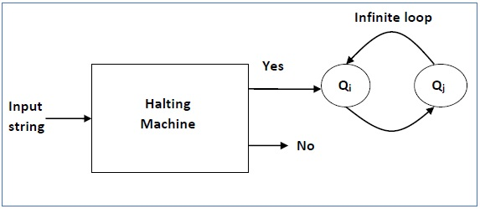
Undecidable Decision Problem
The Halting Problem
Determine from a description of an arbitrary computer program and an input whether the program will finish running (i.e., halt) or continue to run forever
Notes:
That means it cannot handle the undecidable decision problem that is not giving you any constant execution time such as the very famous halting problem. In the halting problem, you need to determine from a description of an arbitrary computer program …
Intuition here is if you want to decide how long this infinite loop will finish, you need to go into that infinite loop. Because it is an infinite loop, once you get in, how do you escape?
This is like the event horizon of a black hole (explain …)

Slide 26
Non-deterministic Turing Machine
An imaginary, very powerful machine that
Can spawn many parallel search paths each solving the problem deterministically
NOT a formal definition but an easy way to understand what a non-deterministic Turing machine is!
If solution checking for some problems can be done in polynomial time on a deterministic machine, then the problem can be solved in polynomial time on a non-deterministic Turing machine
Non-deterministic two stages:
make a guess what the solution is
check whether the guess is correct
Notes:
So, that is deterministic turing machine. There is also a non-deterministic turing machine which operates in a different manner. A non-deterministic turing machine is an imaginary machine, very powerful machine that …

Slide 27
Complexity Classes: NP Class
Class NP contains those problems that can be solved in polynomial time on a non-deterministic Turing machine
Alternatively, NP is the set of decision problems for which the problem instances, where the answer is "yes", have proofs verifiable in polynomial time by a deterministic Turing machine
All problems
NP
P
https://en.wikipedia.org/wiki/NP_(complexity)
Notes:
With that definition, we can define another complexity class, the NP class. Class NP (explain…)
The set diagram looks like the following: You have all the problems, then you have NP containing P (assuming P!=NP) because non-deterministic turing machine is more powerful and can solve many more problems. This is again not a very formal and correct way to express the set, but it is a intuitive way to look at this problem.
(another definition) NP is the set of decision problems for which the problem instances, where the answer is "yes", have proofs verifiable in polynomial time by a deterministic Turing machine

Slide 28
NP-complete Problem Class
A question which is still not answered:
P = NP or P ≠ NP
There is a strong belief that P≠ NP, due to the existence of NP-complete problems (NPC)
All NPC problems have the same degree of difficulty
If one of them could be solved in polynomial time, all of them would have a polynomial time solution
Notes:
Like I said, this is not accurate because we don’t know whether P equal to NP or P != NP. This is still top-10 problems to solve in the community. And I believe if you are able to solve it, you will win the nobel prize in math and computer science.
But, there is a strong … (explain)

Slide 29
NP-complete Problem Definition
A problem is NP-complete if and only if
It is in NP
Every problem in NP is reducible to the problem
This condition alone make the problem NP-hard (discussed later)
There is a strong belief that P≠ NP, due to the existence of NPC problems.
NP
NPC
P
Notes:
So, a problem is NP-complete if and only if (explain …)

Slide 30
What is “Reducible”?
If we can solve problem A, and if problem B can be transformed into an instance of problem A with polynomial time, then we can solve problem B by reducing problem B to problem A and then solve the corresponding problem A
B <_{p} A
(the symbol “>” hints that A is at least or more difficult than B)
Example:
Problem A: Sorting
Problem B: Given n numbers, find the i-th largest numbers.
Polynomial-time Reducible
Notes:
So, what is reducible? (explain …)
This reducible idea is like a family tree, right? You have your grand parents, then your parents, and your siblings, sisters and brothers who also become parents of another family tree, etc. The question here is, what is the root? For a tree to present and grow, you need a root. What is the first problem that makes this reduction happen?

Slide 31
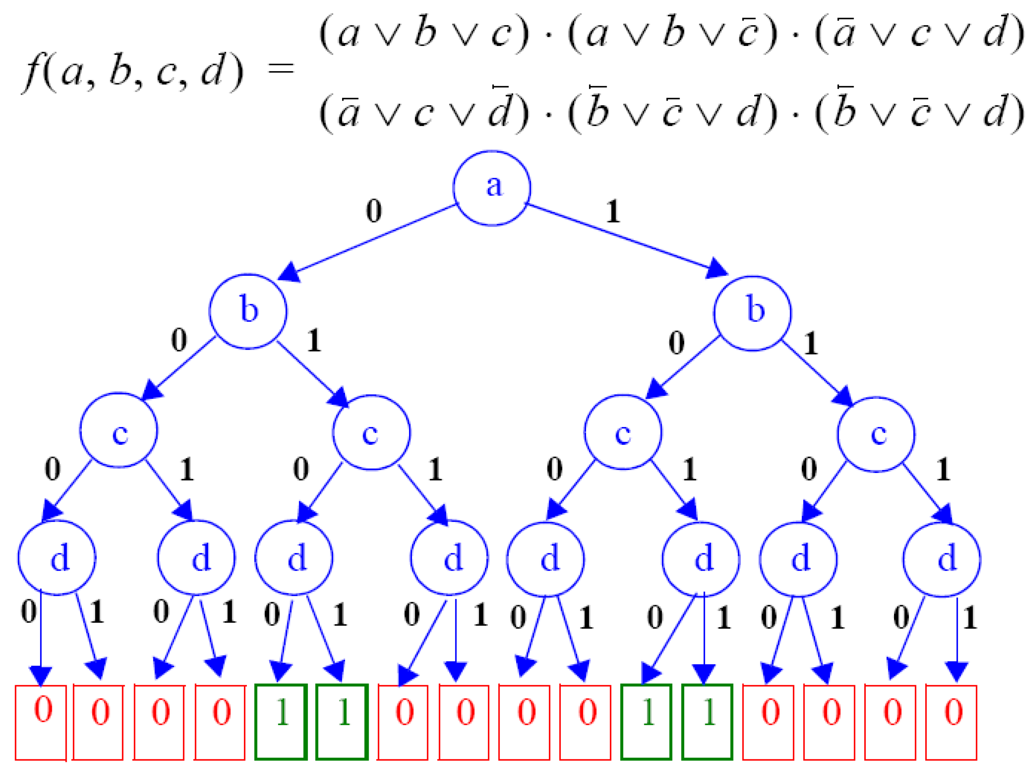
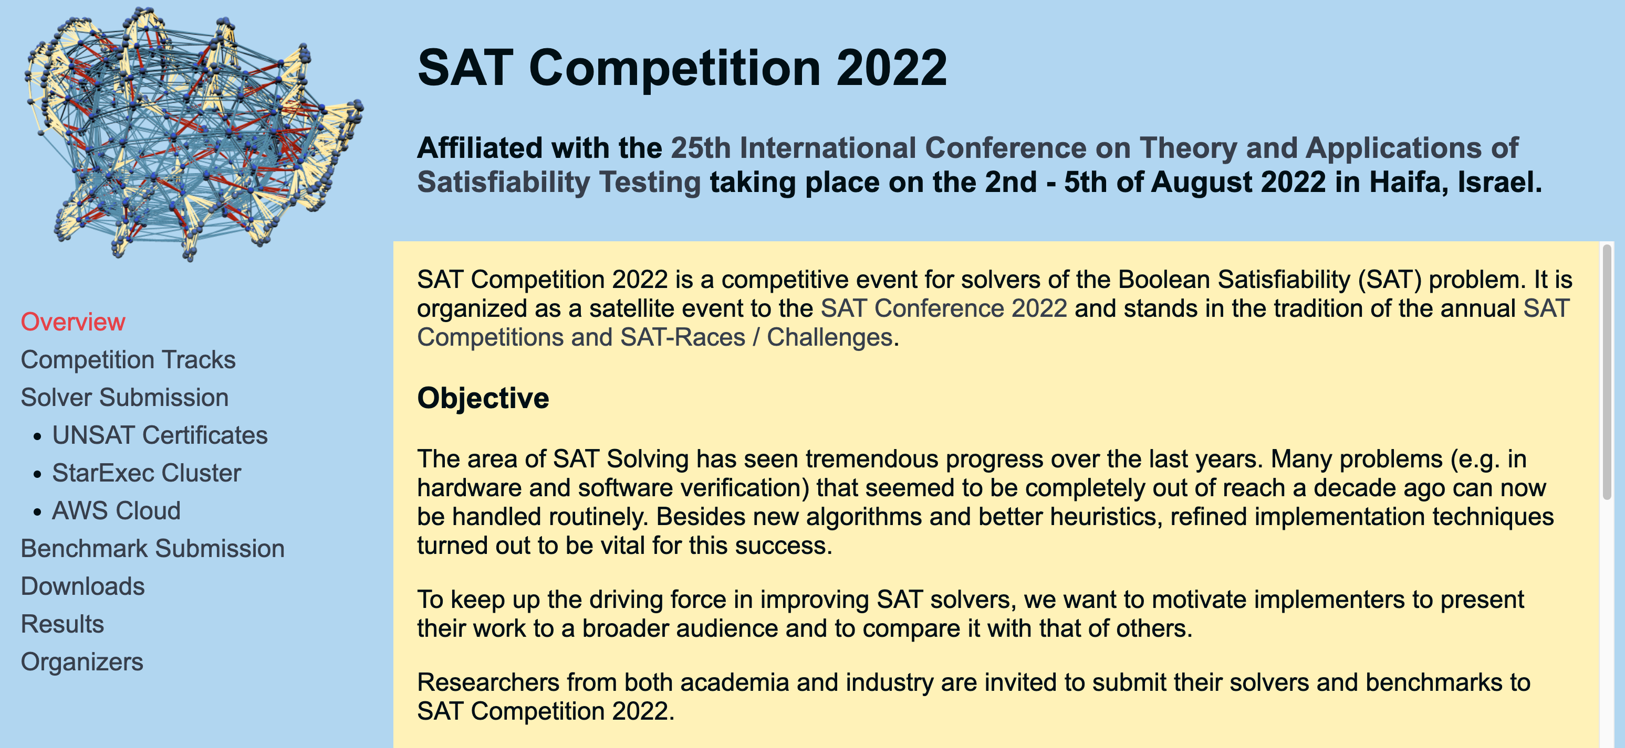
First NP-complete Problem: Satisfiability
Cook’s theorem
SATISFIABILITY (SAT) is NPC
The first NPC problem
Every NP problem reduces to SAT
SAT Problem: Can we find an input for f(a, b, c, d) to be 1?
https://satcompetition.github.io/2022/
Notes:
The first NP complete problem that makes all this reduction idea to work is “satisfiability” or the “SAT” problem. Given a Boolean logic function with AND operation and OR operations taking effect on a set of Boolean variables, can we find an input for the function to be 1. In other words, can this function ever return one! We know if you have an AND function with one input equal to zero you will never get one, right? This is the SAT problem, the first NPC problem introduced by Cook who is a professor in UC B.
Today, there are still many people trying to come up with new algorithms to solve SAT, and we don’t know yet whether a polynomial time complexity algorithm exists or not. For example, the famous SAT competition organized by the community has called for participation every year to seek novel solutions for SAT. You can go visit this website to find more details.
The takeaway here is, all the NP problems eventually can be reduced to SAT, and if you are able to solve SAT then the whole thing collapsed.

Slide 32
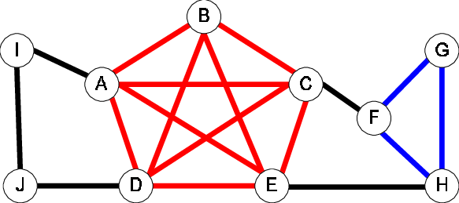
NP-complete Problem Examples
Clique finding problem
Input: graph G = (V,E), positive integer K ≤ |V|
Question: does G contain a clique of size K or more?
Minimum cover problem
Input: collection C of subsets of a finite set S, positive integer K ≤ |C|
Question: does G contain a cover for S of size K or less?
Notes:
Let’s take a look at some NP-complete problem examples. The clique finding problem is a very famous NPC problems. (explain …)

Slide 33
NP-complete Problem Examples (cont’d)
Circuit set problem
Take a Boolean circuit with a single output node and ask whether there is an assignment of values to the circuit’s inputs so that the output is “1”
Logic Gates
0
1
0
1
1
NOT
1
1
0
OR
1
1
0
0
1
AND

Slide 34
NP-complete Problem Examples (cont’d)
Knapsack problem
Can we translate a subset of rectangles to have their bottom edges on L so that the total area of the rectangles touching L is at least s?
5
6
2
3
4
7
1
L
s

Slide 35
World of NP: Assuming P != NP
NP
NPC
P
Notes:
This is what we have so far, assuming P is not equal to NP. The community has a strong belief in this because of the presence of NPC.

Slide 36
NP-Hard Problems
Any decision problem (inside or outside of NP) to which we can transform an NP-complete problem to it in polynomial time will have a property that it cannot be solved in polynomial time, unless P = NP
Such problems are called NP-hard
“as hard as the NP-complete problems”
Notes:
The next category is NP-hard. This is a class that is very similar to NP complete except we don’t know if it becomes to NP. Remember a problem is NPC if and only if it belongs to NP and every problem in NP is reducible to that problem.

Slide 37
NP-Hard, NP, and NPC
NP-Hard
NP
NPC
P
Notes:
The set diagram looks like this. We see NPC is essentially the interaction between NP and NP-hard, and NP-hard by definition does not necessary have to go into NP.

Slide 38
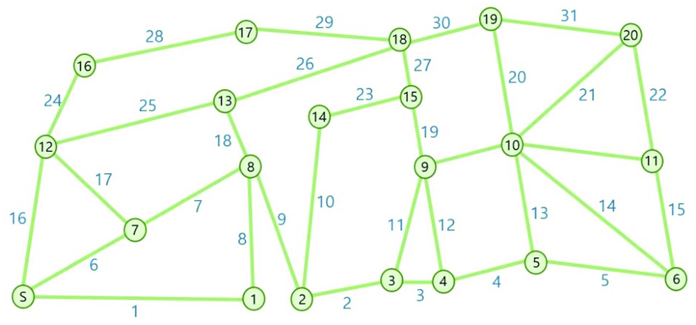
NP-hard Problem Examples
Traveling salesman problem (TSP)
Given a list of cities and the distances between each pair of cities, what is the shortest possible route that visits each city exactly once and returns to the origin city?
Notes:
A very famous NP-hard problem example is the TSP, traveling salesman problem. Given a list of cities … (explain)

Slide 39
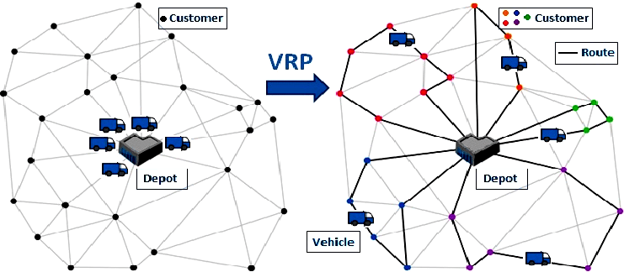
Applications of TSP
Vehicle routing problem (VRP)
Notes:
Traveling salesman problem has tremendous application in our daily lives. For example, vehicle routing is a variant of TSP and is something that we are using pretty much every day. The problem is to decide an optimal route from a depot for all trucks to deliver things to customers, and we want to minimize the total traversed distance.
In this figure, the optimal route looks like the following: (explain…)

Slide 40

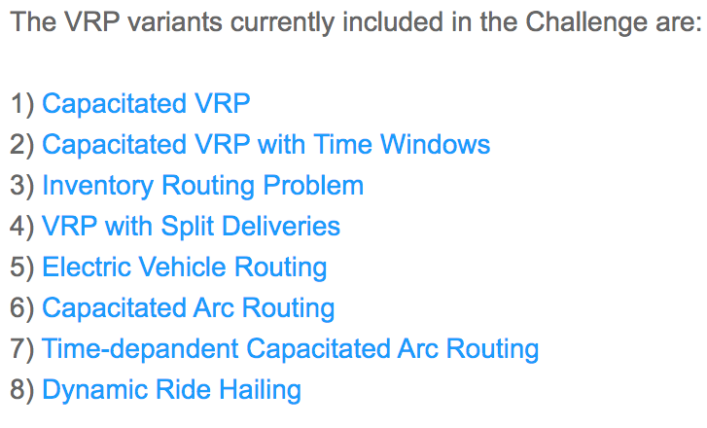
Applications of TSP (cont’d)
2020-2022 DIMACS Implementation Challenge: http://dimacs.rutgers.edu/programs/challenge/vrp/

Slide 41
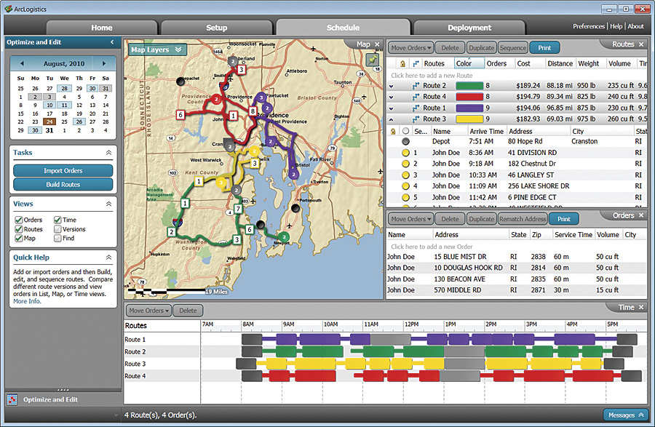
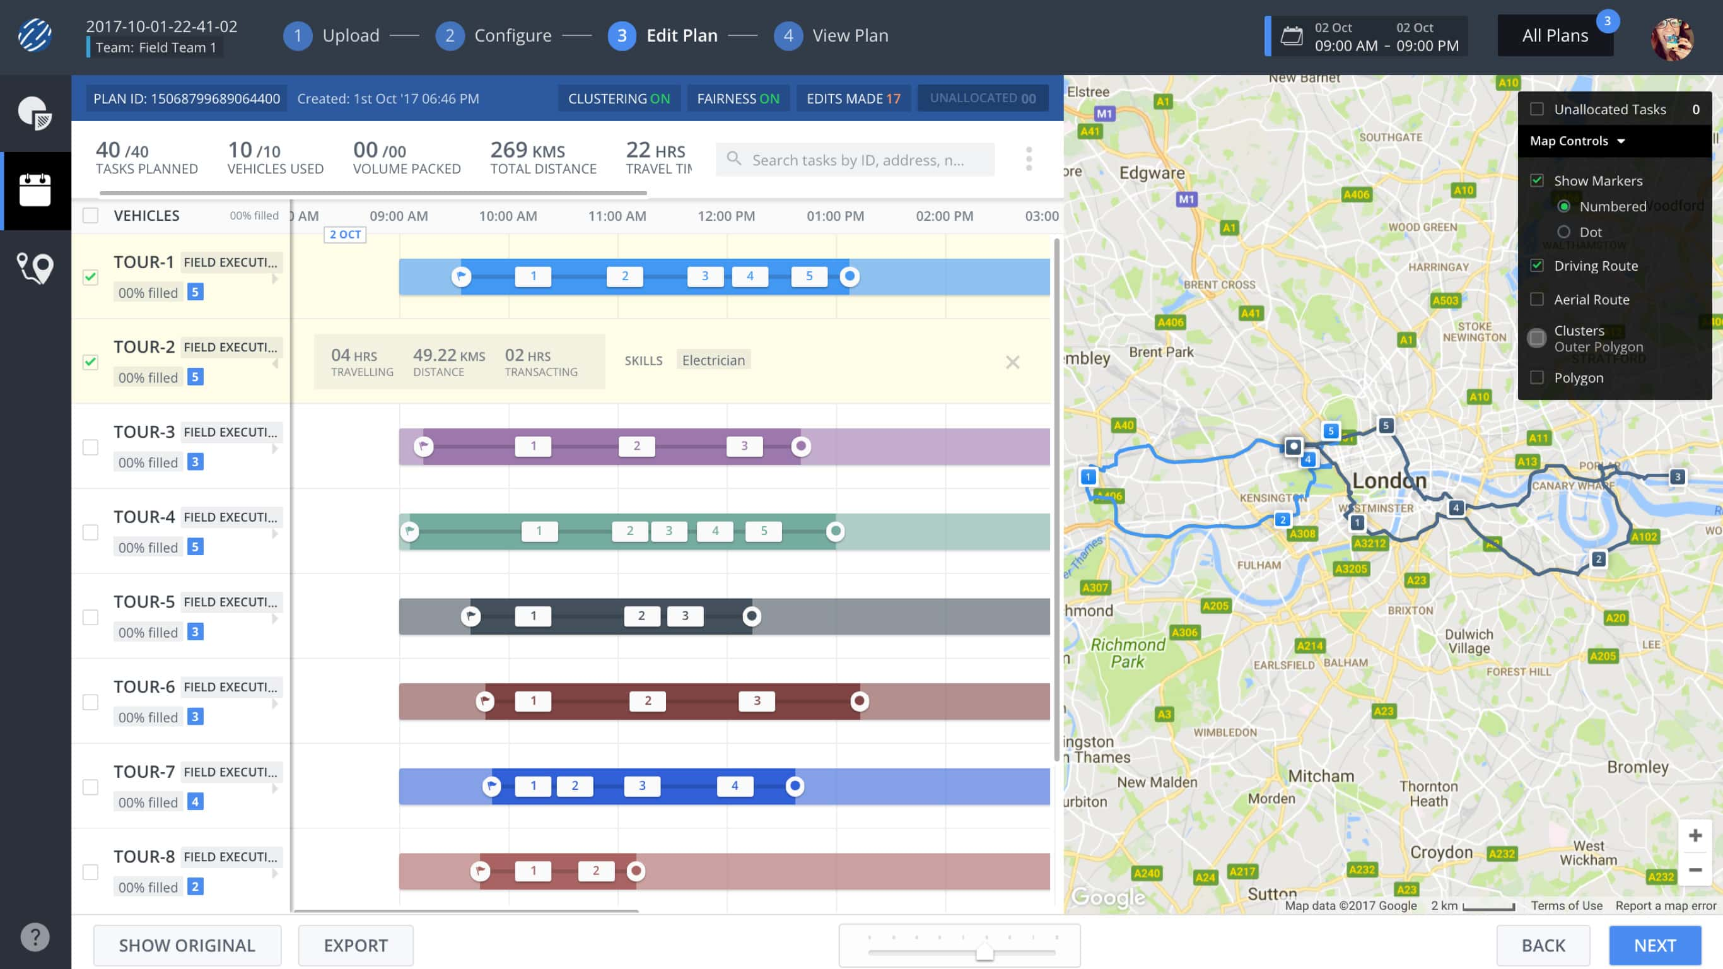

Vehicle Routing Software Solution

Slide 42
Practical Consequences
Many physical design problems are NPC or NP-hard
Exact solutions to such problems are often of exponential complexity
Exact solutions to such problems can only be found when the problem size is small (e.g., N<=20)
One should instead focus on sub-optimal solutions by
Approximation algorithms: they can guarantee a solution within e.g. 20% of the optimum
Heuristics: nothing can be said a priori about the quality of the solution (experience-based)
Notes:
So far, we have talked about algorithm complexity. The practical consequences here is that (explain …)

Slide 43
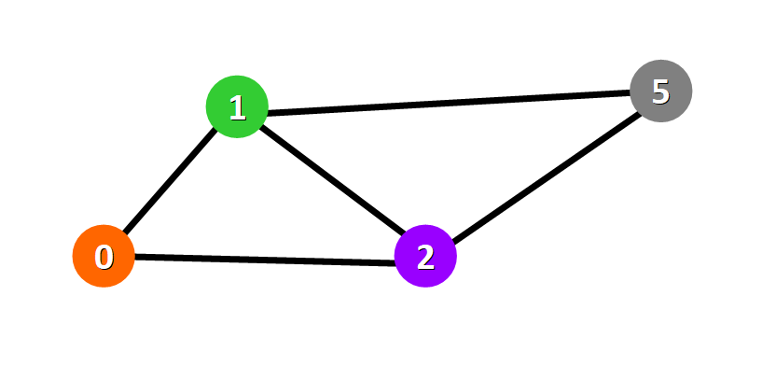
Example
Tractable and intractable problems can be very similar:
the SHORTEST-PATH problem for undirected graphs is in P
the LONGEST-PATH problem for undirected graphs is NP-complete

Slide 44
Summary
The class NP-complete is a set of problems which we believe there is no polynomial time algorithms
Therefore, it is a class of hard problems
NP-hard is another class of problems containing the class NP-complete
However, we don’t know if it belongs to NP
If we know a problem is in NP-complete or NP-hard, you have little hope to solve it efficiently
Just keep this in mind if you still don’t understand it …

